Slide 1
Argus
A Human Verification and Digital Trust Platform
STUDENT GROUP PROJECT (SGP)
Project Guide
Team Members
Mr. Sudheesh Patel
Shafin Nigamana
Team Lead
Chaitanya Thakkar
Team Member
Hetavi Subagiya
Team Member

Slide 2




PROBLEM STATEMENT
The Gap in Traditional Authentication
What Current Systems Verify
What Current Systems Cannot Always Verify
Identity
Human Presence
Username and account credentials
Genuine user at authentication time — not an automated agent or replay
Credentials
Passwords, tokens, and certificates
Replay Attack Resistance
Protection against recorded or synthesized credential re-use
AI Impersonation Resistance
Defense against AI-assisted spoofing and deepfake-class attacks
Requirement: A multi-layer human verification platform that combines physiological, behavioral, and challenge-response signals to establish digital trust — beyond what credential-based systems alone can achieve.

Slide 3


TECHNICAL FOUNDATION
Understanding rPPG
Remote Photoplethysmography (rPPG)
Role Within Argus
Non-contact measurement of heart rate derived from subtle skin color variations captured on video. Blood volume changes under the skin modulate reflected ambient light, which a standard camera can detect and quantify.
Important scope clarification: rPPG is one physiological verification signal. It contributes physiological evidence to the multi-layer framework — it does not verify human presence in isolation.
Signal Processing Pipeline
Capture
Signal Characteristics
Detect Face
Input
ROI
Standard RGB video feed
Forehead and cheek regions
Extract ROI
Extract RGB
Output
Estimated heart rate (BPM)

Slide 4
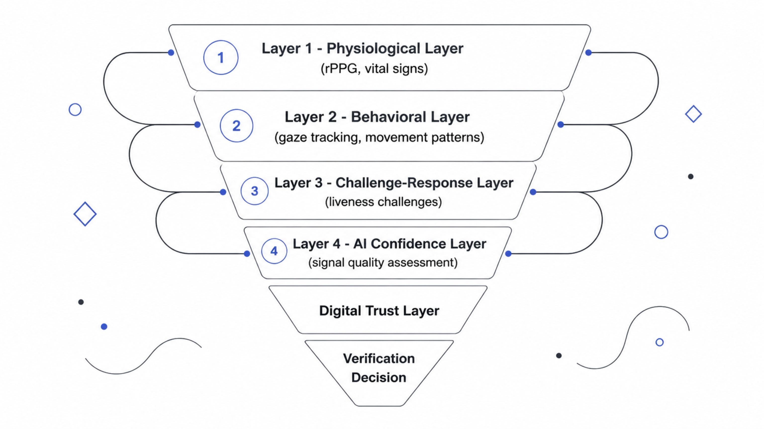
PROPOSED SOLUTION
Argus Multi-Layer Verification Framework
Layer Descriptions
Decision Logic
Layer
Signal Type
Examples
The verification decision is generated by combining multiple independent signals through a decision fusion algorithm. No single signal is authoritative — the framework is designed to be resilient to the failure or spoofing of any individual layer.
Physiological
Biometric
rPPG, vital sign indicators
Behavioral
Interaction patterns
Gaze, movement cadence
Challenge-Response
Active liveness
Prompted user actions
AI Confidence
Signal quality
Noise assessment, confidence scores

Slide 5

EXISTING WORK & RESEARCH
Foundation: What Has Been Completed
1
Prototype Study
Studied the existing Argus prototype developed during the Google Solution Challenge — examining its architecture, feature set, and design decisions in detail.
2
Architecture Analysis
Systematically analyzed prototype strengths, structural limitations, and gaps relative to the proposed multi-layer verification framework.
3
Literature Review
Conducted a structured literature review covering human verification approaches, rPPG signal processing, behavioral biometrics, and liveness detection methods.
4
Technology Evaluation
Evaluated candidate technology stacks and frameworks against the project's scalability, modularity, and academic feasibility requirements.
5
Scope Redefinition
Redefined the project scope for the SGP based on research findings — establishing clear boundaries between what was inherited from the Solution Challenge and what constitutes new engineering work.
Outcome: Comprehensive understanding of the problem domain, existing solution landscape, and technical feasibility — providing a validated foundation for the proposed architecture.

Slide 6

TECHNICAL DECISIONS
Platform Architecture & Technology Stack
Component
Technology
Rationale
Frontend
React Web
Scalability, broad browser integration, dashboard support
Backend
Spring Boot
Modular architecture, enterprise-grade reliability
Database
PostgreSQL
Relational data model, full ACID compliance
Architecture Pattern
Modular Monolith
Layered design with clear separation of concerns
Methodology
Agile Scrum
Iterative development with regular feedback cycles
Architectural Philosophy
Future Module — Phase 4: A Chrome Extension is planned for Phase 4 after the core web platform has been completed and validated. It is not part of the initial implementation scope.
The modular monolith pattern was selected to balance engineering rigor with academic feasibility. Clear layer boundaries ensure that individual verification modules — physiological, behavioral, challenge-response — can be developed, tested, and replaced independently without coupling concerns.

Slide 7


RISK & MITIGATION
Challenges & Proposed Solutions
Lighting Conditions & Signal Quality
Platform Scalability
Challenge: rPPG signal fidelity degrades under variable or poor ambient lighting conditions, reducing physiological layer reliability.
Proposed Solution: Adaptive signal quality assessment and preprocessing pipeline to detect low-confidence conditions and flag or exclude affected frames before estimation.
Challenge: Multi-signal verification introduces concurrent processing demands that must scale without architectural fragility.
Proposed Solution: React web frontend with a modular Spring Boot backend — service boundaries designed for independent scaling of verification components.
Multi-Signal Decision Fusion
Cloud Dependency & Vendor Lock-in
Challenge: Combining heterogeneous verification signals (physiological, behavioral, challenge-response) into a single reliable decision requires a principled fusion approach.
Proposed Solution: Research and develop a decision fusion algorithm drawing on established verification and signal combination techniques — to be defined during Phase 3.
Challenge: Direct cloud service dependencies create operational risk and reduce deployment flexibility.
Proposed Solution: Modular cloud deployment architecture with abstraction layers isolating vendor-specific integrations from core platform logic.

Slide 8

PROJECT ROADMAP
Implementation Phases
Phase 1
Phase 2
Planning & Architecture
Core Platform
Research & literature review
Architecture design
Tech stack evaluation
Frontend (React)
Backend (Spring Boot)
Database (PostgreSQL)
API design
COMPLETED
Phase 3
Phase 4
Verification Engine
Dashboard & Extension
rPPG pipeline
Behavioral analysis
Challenge-response
Decision fusion
Admin dashboard
Testing & QA
Deployment
Chrome Extension
Expected Outcome
Current Status: Phase 1 is complete. The team has established architecture, selected the technology stack, and validated technical feasibility through prototype analysis and literature review. Phase 2 development is the immediate next milestone.
A reusable human verification and digital trust platform with a modular architecture designed for integration into authentication systems. Each verification layer — physiological, behavioral, challenge-response — will be independently testable and replaceable, providing a practical foundation for future research and engineering extensions.

